Slide 1
Leadership Exchange
Quarterly Meeting – August 2021

Slide 2

Welcome to Our First Leadership Exchange Webinar
Honors & Introductions
hello…

Slide 3
Roles: Thank You for Your Participation
GoldSpring Consulting
Leadership Exchange
Quarterly Updates
Facilitate Group Exchange
Opportunities to Present
Annual State of Industry for Your Executives
Private Resource Web Page
Peer Networking
Benchmarking
Participation (as you are able)
  Polls
  This Forum
Continued Leadership
  Bring Forward Internal/External Challenges
  Share Ingenuity
https://www.goldspringconsulting.com/leadership

Slide 4

Our Agenda Today
Recent Happenings & What to Watch
  TMC
  Air
  Hotel
  Meetings
GoldSpring Answers Your
Important Questions
Exchange Open Discussion

Slide 5
Recent Happenings & What to Watch

Slide 6
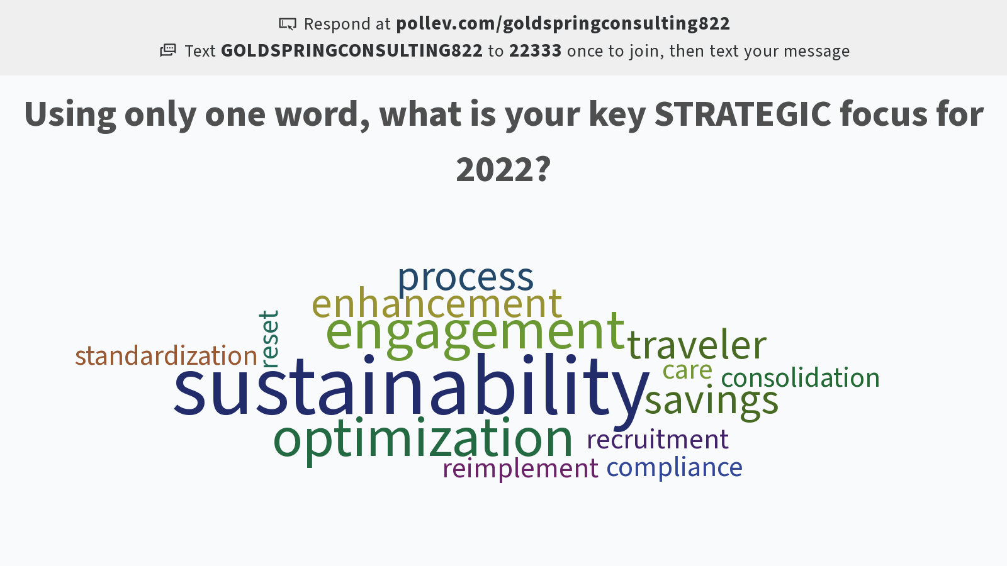
Notes:
Poll Title: Do not modify the notes in this section to avoid tampering with the Poll Everywhere activity.
More info at polleverywhere.com/support
Using only one word, what is your key STRATEGIC focus for 2022?
https://www.polleverywhere.com/free_text_polls/3TwrBH7eTvxyZ0SWKdlDM

Slide 7

TMC: Recent Happenings & What to Watch
Industry Consolidation
Financial Changes
Operational Changes
Hotel and Mobile Emphasis
Notes:
Ind Consolidation - odd combinations, additional financial investment from GDS, OBT, unusual alignment

Slide 8
What’s the most important focus for your 2022 air program?

Slide 9
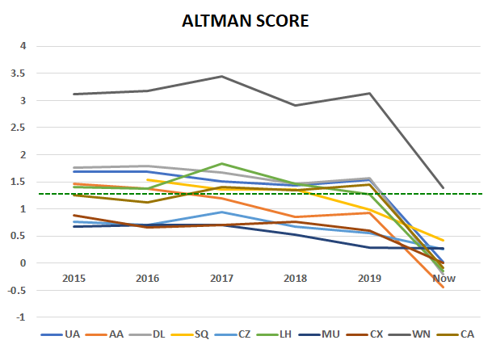
Air: Recent Happenings & What to Watch
Altman Score: Chance of Bankruptcy
(within 2 years)
Intended Use: Stock Investment Screening
Risk Level: Score Between 1.8 and
2.99 “caution”
Caveat: Industries which operate with
high leverage such as airlines will always
show a more unfavorable score
Airline Industry:
  2015 – 2019 Highly Profitable Years
  We can assume Avg. Score of 1.3 is
  a reliable indicator of airline health
  COVID-19 Severely Impacted Industry

Slide 10

Air: Recent Happenings & What to Watch
Virgin Australia: Restructured airline, different pricing model. Ceased partnerships with SQ, DL
AA: Relationships with Jet Blue, Alaska and JetSmart
Latin America: Highly stressed region with many of the key airlines having ceased operations at times during Covid
US downgrades Mexico safety rating. Same level as Thai Airlines and Malaysian
Increased focus on sustainability reporting
Recent sourcing has produced positive results and airlines have still been prepared to use 2019 data for RFPs

Slide 11
Air: Sustainability
System Developments
Electric Airplanes
Carbon Neutral date
Renewable Energy
  Bio Fuels, Solar, Wind, Credits
  CO2 per passenger
Offset Efforts
Policy Developments
Aircraft type
Alternatives: Rail / Teleconferencing
Direct Flights Versus Connections
Class of Service

Slide 12
What’s the most important focus for your 2022 hotel program?

Slide 13

Hotel: Recent Happenings & What to Watch
Preparing for 2022 season with flexible rollover proposals
Pricing has begun to return to pre covid levels
“YES unless supporting data volume increase for consolidated hotels is provided to support a more competitive rate”
“Our global position is not to just roll over all of the contracts from 2021 to 2022. It should be looked at by account and market”
“No. We will do whatever the
customer prefers.”
“Since there’s barely any production due to pandemic, we encourage all our clients to roll over however new bids are still doable.”

Slide 14
Technology Platforms
Lanyon / Cvent Business Transient has upgraded its system to cater for the static rate + float option
Other platforms such as HRS, Readybid may not be supported by the central chain contact and will need to go to individual properties
Rate re shopping sourcing capabilities
BTP automation is also entering the arena with data consolidation, re shopping and sourcing capabilities
We currently are not actively engaged with HRS on chain level as HRS has decentralized RFP process.
We do not currently import HRS RFPs into our central Lanyon domain as there are too many errors with outputting them back to HRS format so we ask hotels to work directly with HRS for those programs.
We do not currently work with Readybid RFP platform either as they don't have NAM central set up for the RFPs so we can't work them centrally. They go direct to hotels and rely on hotels to answer and load their own rates.
If a client uses a different RFP platform, then we will run the RFP in Cvent/ Lanyon and pull the file to upload into the clients preferred RFP tool.

Slide 15
What’s the most important metric within your company’s meeting program?

Slide 16
What’s the most important metric within your meeting program? (Meetings Management Master Class 1)

Slide 17

Meetings: Recent Happenings & What to Watch
Meetings are increasing: Leisure, meetings, and then business travel
New meeting dynamics
  Virtual meeting on demand element is changing static meeting dates
  Companies are producing one event with two experiences: the hybrid.
  Production has moved to “broadcast quality” to keep attendees engaged
Key metrics have slightly shifted
  Attendee engagement

Slide 18
Which of the following areas would you be interested in more comprehensive benchmarking?
Notes:
More in-depth polls we’re glad to facilitate

Slide 19

Open Exchange

Slide 20
Wrap Up
Recap of Benefits:
  Rapid response polls
  Your desired polls for future
  Appear on any panels/presentations and article inclusion
  Invitation to executive presentation:
    to enhance advocacy for your initiatives
    to enhance value of your program
Our Next Meeting: Q4

Slide 21
Leadership Exchange
Quarterly Meeting – August 2021

